Slide 1
Capstone Project-3
Credit-Card-Default-Prediction
Ansh Bhatnagar
Sandeep Kumar Maurya

Slide 2
Problems to resolve
Problem Statement
Purpose of Project
● ML applications focused on
credit score predicting.
● Relying on credit scores and
credit history.
● Miss valuable customers with no
credit history. I.e. immigrants.
● Regulatory constraints on
banking industry forbids some
ML algorithms.
● Conduct quantitative analysis
on credit default risk by
applying three interpretable
machine learning models
without utilizing credit score or
credit history.

Slide 3



Who Should Care?
Credit Card Companies
Commercial Banks

Slide 4
Approach Overview
Data Cleaning
Data Exploration
Predictive Modeling
Understand and Clean
Graphical and Statistical
Machine Learning
● Find information on
undocumented
columns values
● Clean data to get it
ready for analysis
● Exam data with
visualization
● Verify findings with
statistical tests
● Logistic Regression
● Random Forest
● XGBoost

Slide 5
Data Acquisition
Dataset
Why This Dataset?
● Default Payments of Credit
Card Clients in Taiwan from
2005
● Source: Public dataset from
Almabetter.
● Original Source: UCI Machine
Learning Repository*
● Real credit card data
● Comprehensive and complete
● 30,000 customers
● Usage of 6 months
● Age from 20-79
● Demographic factors
● No credit score or credit history

Slide 6
What demographic factors
impact payment default risk?
Part 1
Exploratory Data
Analysis

Slide 7
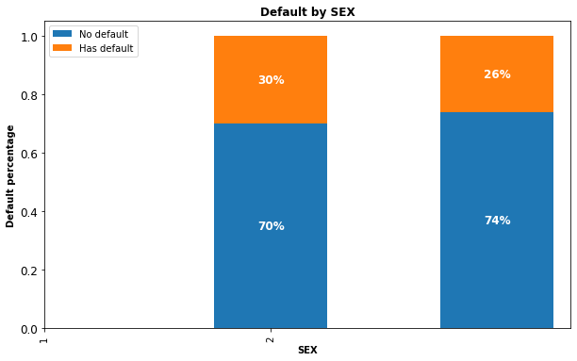
Gender Variable
30% of males and
26% of females
have payment
default.

Slide 8
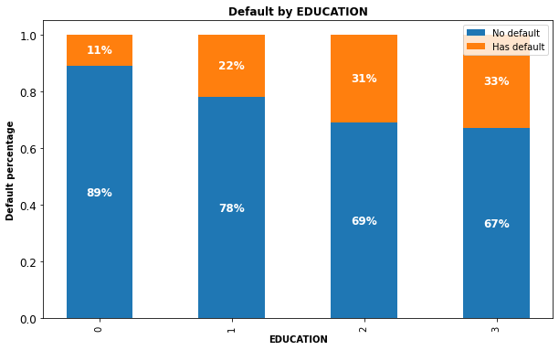
Education Variable
Higher education
level, lower default
risk.

Slide 9
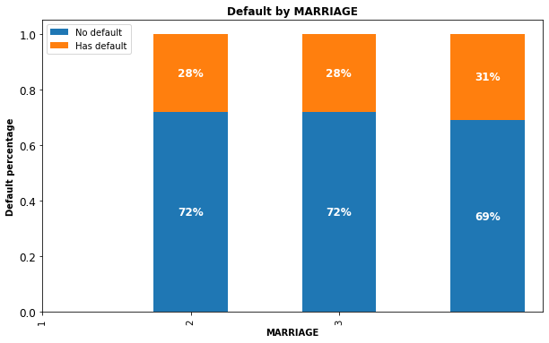
Marital Status Variable
No significant
correlations of
default risk and
marital status

Slide 10
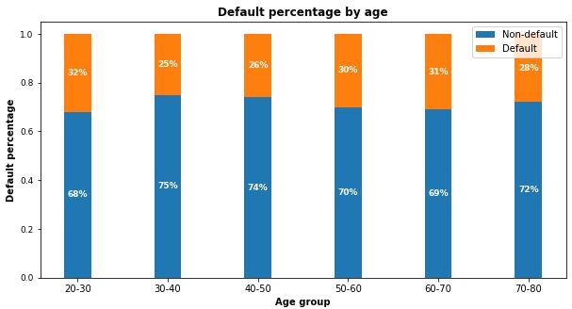
Age Variable
30-50:
Lowest risk
< 30 or >50:
Risk increases

Slide 11
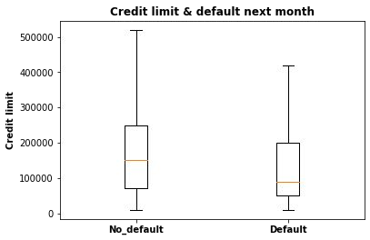
Credit Limit Variable
Higher credit limits,
lower default risk.

Slide 12
EDA Summary
● Demographic factors that impact default risk are:
○ Education: Higher education is associated with lower default risk.
○ Age: Customers aged 30-50 have the lowest default risk.
○ Sex: Females have lower default risk than males in this dataset.
○ Credit limit: Higher credit limit is associated with lower default risk.

Slide 13
What demographic factors
impact payment default risk?
Part 2
Predictive Modeling

Slide 14
Modeling Overview
Define Problem:
Supervised learning / binary classification
Imbalanced Classes:
78% non-default vs. 22% default
Tools Used:
Scikit learn library and imblearn
Models Applied:
Logistic Regression / Random Forest / XGBoost

Slide 15
Modeling Steps
Data Pre-processing
Fitting and Tuning
Model Evaluation
● Feature selection
● Feature engineering
● Train-test data splitting
(70%/30%)
● Training data rescaling
● SMOTE oversampling
● Start with default model
parameters
● Hyperparameters
tuning
● Measure ROC_AUC on
training data
● Models testing
● Precision_Recall score
● Compare with sklearn
dummy classifier
● Compare within the 3
models

Slide 16
Correct Imbalanced Classes
● Fit every model without and with SMOTE oversampling for comparison.
● Training AUC scores improved significantly with SMOTE.
Models | AUC Without SMOTE | AUC With SMOTE
Logistic Regression | 0.726 | 0.797
Random Forest | 0.764 | 0.916
XGBoost | 0.762 | 0.899

Slide 17
Hyperparameters Tuning
● K-Fold Cross Validation to get average performance on the folds.
● Randomized Search on Logistic Regression since C has large search space.
● Grid Search on Random Forest on limited parameters combinations.
● Randomized Search on XG Boost because multiple hyperparameters to tune.

Slide 18
Model Comparisons
● Compare the models to Scikit-learn’s dummy classifier.
● All models performed better than dummy model.
Models | Precision | Recall | F1 Score | Conclusion
Dummy Model | 0.217 | 0.500 | 0.303 | Benchmark
Logistic Regression | 0.384 | 0.566 | 0.457 | Best recall
Random Forest | 0.513 | 0.514 | 0.514 | Best F1
XGBoost | 0.444 | 0.505 | 0.474

Slide 19
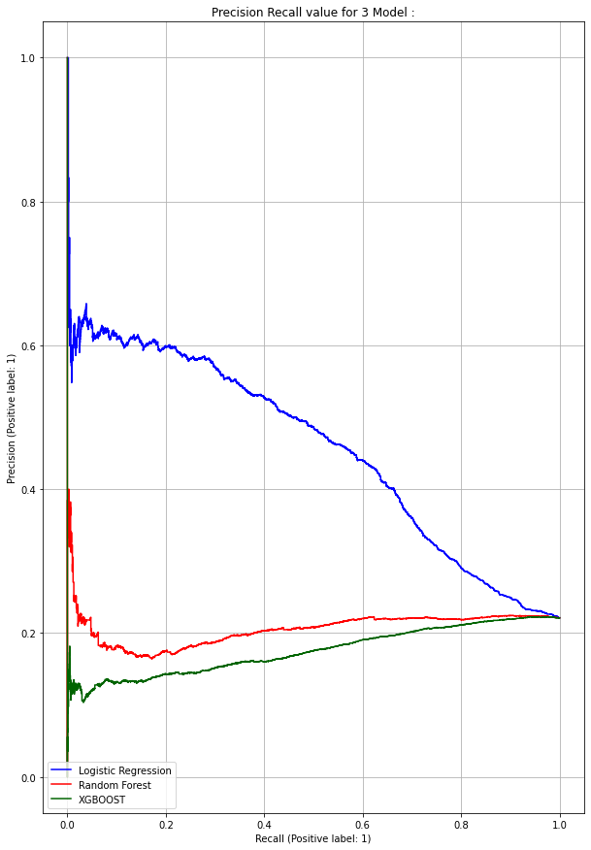
Model Comparisons
● Compare within 3 models.
● Random Forest (red line) has
the best precision_recall score.
Terminology:
.
★ Recall: how many 1s are
being identified?
★ Precision: Among all the
1s that are flagged, how
many are truly 1s?
★ Precision and recall
trade-off: high recall will
cause low precision

Slide 20
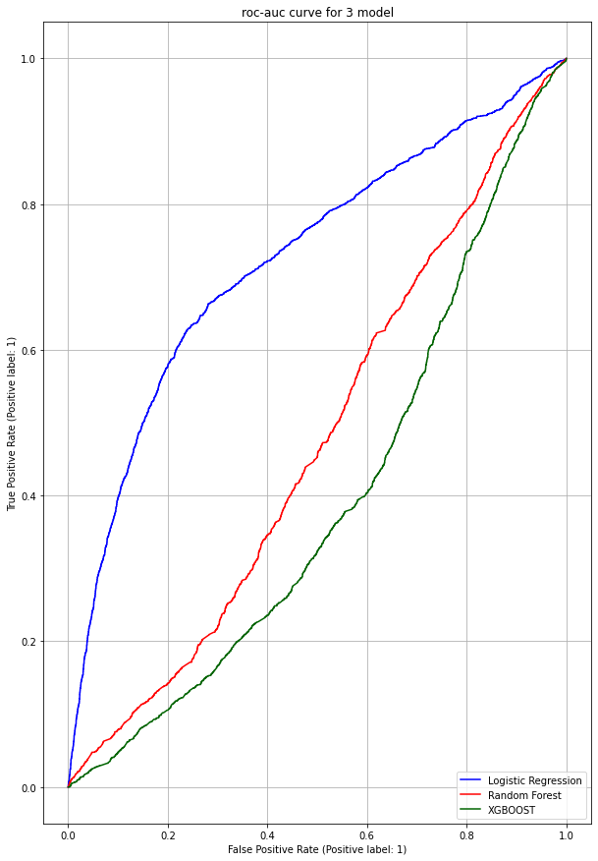
ROC-AUC curve for
3-D Model

Slide 21
Limitations & Future Work
Limitations
● Best model Random Forest can only
detect 51% of default.
● Model can only be served as an aid in
decision making instead of replacing
human decision.
● Used only 30,000 records and not
from US consumers.
Future Work
● Models are not exhaustive. Other
models could perform better.
● Get more computational resources to
tune XG Boost parameters.
● Acquire US customer data and more
useful features I.e. customer income.

Slide 22
Conclusions
● Recent 2 payment status and credit limit are the strongest default
predictors.
● Dormant customers can also have default risk.
● Random Forest has the best precision and recall balance.
● Higher recall can be achieved if low precision is acceptable.
● Model can be served as an aid to human decision.
● Suggest output probabilities rather than predictions.
● Model can be improved with more data and computational resources.

Slide 23
Thank you!
Ansh Bhatnagar- 123anshbhatnagar@gmail.com
Sandeep Kumar Maurya- sandeepskm13@gmail.com
GitHub Link: -
Ansh Bhatnagar: - https://github.com/AnshRockstar/Credit-Card-Default-Analysis
Sandeep Kumar Maurya: - https://github.com/San13deep/Credit-Card-Default-Prediction

